Slide 1

CLASS PROJECT : ANALYSIS OF CRYPTOCURRENCY
ALY6030: Data warehousing & sql
May 17th, 2022
submitted TO : Dr. Hema Seshadri BY David Joseph Johnson

Slide 2

David Joseph Johnson From: Bangalore, India Areas of Interest: Business Intelligence Course: MPS in Analytics, Northeastern University Educational Background: Bachelor of Technology (Computer Science) Professional Experience: Backend Web Developer Hobbies: Football, Music

Slide 3

INTRODUCTION
Cryptocurrency
Analysts estimate that the global cryptocurrency market will be more than triple by 2030, hitting a valuation of nearly $5 billion.
Crypto or Cryptocurrency is a digital or virtual currency
Secured by cryptography hence nearly impossible to counterfeit or double-spend
Most cryptocurrencies are based on blockchain technology
PRO’S
Cheaper and Faster Money Transfers
Decentralized (do not collapse at a single point of failure)
CON’S
Price Volatility
High energy consumption for mining activities
Use in criminal activities

Slide 4
PROJECT OVERVIEW
Tools
Python
R Programming
Microsoft Excel
SQL
Implementation
Analyzed data pertaining to the Top 5000 cryptocurrencies
Data streamed from CoinMarketCap website
Goals
Data streamed from CoinMarketCap website
Analyzed data pertaining to the Top 5000 cryptocurrencies
Data Cleaning Exploratory Data Analysis
Gather Insights for Novice Investors
Create Database which can be used to Query Info and build services

Slide 5
BUSINESS QUESTIONS
What is the Central Tendencies of Price ?
What are the currencies that would be suitable for mining?
What currencies are good for exchange and payments?
Which are the stable coins in a given price range?
Which are the volatile coins in the price range?
Which are the Top Drops in a given time period?
Which are the Top Rises in a given time period?
Which coins are almost completely mined? Most dominating coin w.r.t market capitalization?

Slide 6
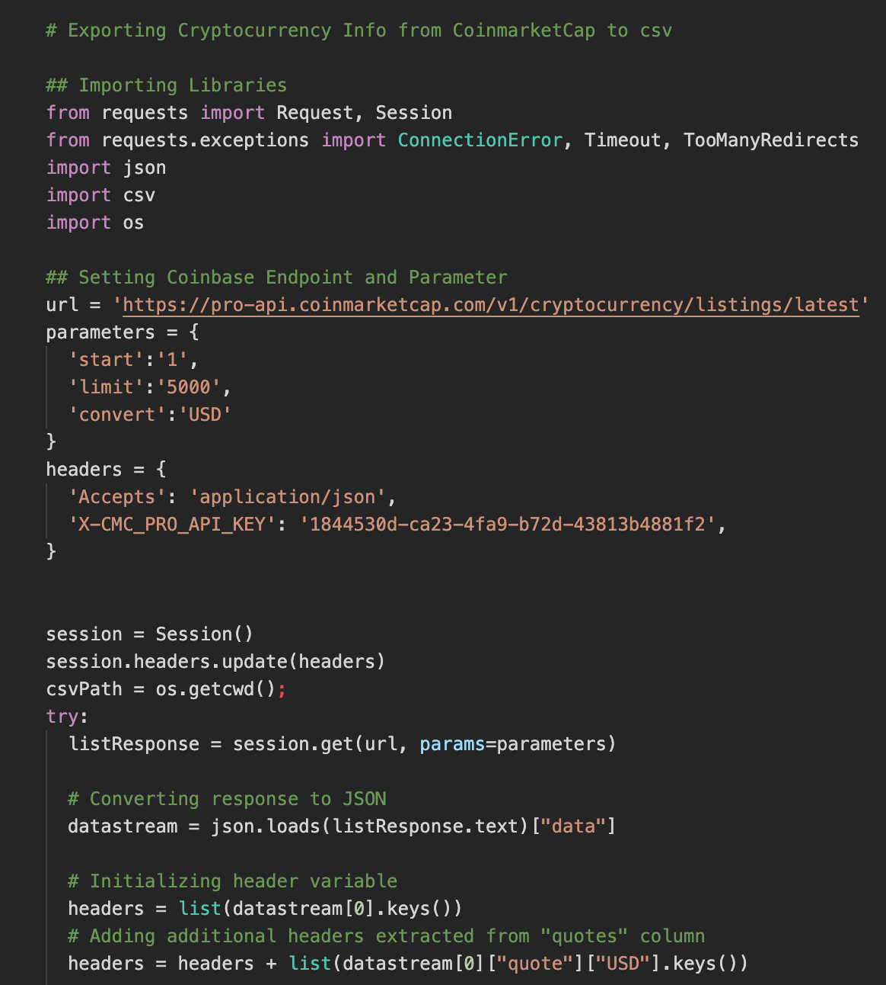
DATA COLLECTION
PYTHON SCRIPT
Ideally web scraping is used to collect large amounts of data from websites
Used the API’s provided by the Coin Market Cap website
APIs provide direct access to the type of data you would want.
While web scraping, the user can access the data only till it is available on a website.

Slide 7
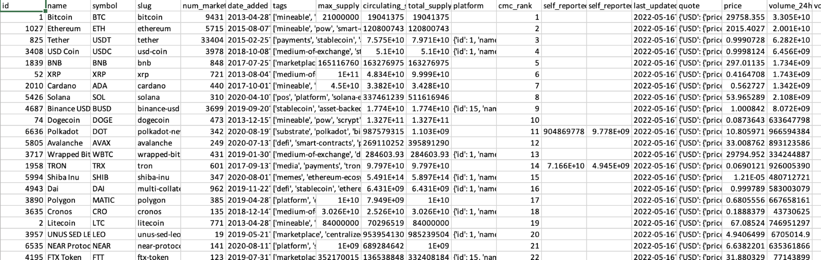
DATA COLLECTION
RAW DATA
Data was retrieved as JSON data streams.
Data was then converted into the required data format and written into a csv file (data.csv).

Slide 8
DATA CLEANING
Columns without intelligible information were removed
NULL and Duplicate values were imputed
3 new columns were added (Mineable, Exchange or Payments)
Records were checked for ‘NA’ values

Slide 9
DATASET OVERVIEW(5000 rows and 29 columns)
id: The unique CoinMarketCap ID for this cryptocurrency.
name: The name of this cryptocurrency.
symbol: The ticker symbol for this cryptocurrency.
num_market: The number of active trading pairs available for this cryptocurrency across supported exchanges.
“Trading pairs” or “cryptocurrency pairs” are assets that can be traded for each other on an exchange
date_added: Timestamp (ISO 8601) of when this cryptocurrency was added to CoinMarketCap.

Slide 10
DATASET OVERVIEW(5000 rows and 29 columns)
max_supply: The expected maximum limit of coins ever to be available for this cryptocurrency.
circulating_supply: The approximate number of coins circulating for this cryptocurrency.
total_supply: The approximate total amount of coins in existence right now (minus any coins that have been verifiably burned)
cmc_rank: The cryptocurrency's CoinMarketCap rank by market cap.
price: Price in the specified currency for this historical.
volume_24h: Rolling 24 hour adjusted volume in the specified currency.
volume_change_24h: 24-hour change in the specified currencies volume.

Slide 11
DATASET OVERVIEW(5000 rows and 29 columns)
percent_change_1h: 1 hour change in the specified currency.
percent_change_24h: 24-hour change in the specified currency.
percent_change_7d: 7 days change in the specified currency.
percent_change_30d: 30 days change in the specified currency.
percent_change_60d: 60 days change in the specified currency.
percent_change_90d: 90 days change in the specified currency.
market_cap: Market cap in the specified currency.
market_cap_dominance: Market cap dominance in the specified currency.
The ratio between the market capitalization of Bitcoin to the total market cap of the entire cryptocurrency market. Market cap is used as an indicator of the dominance and popularity of cryptocurrencies.

Slide 12
DATASET OVERVIEW(5000 rows and 29 columns)
fully_diluted_market_cap: Fully diluted market cap in the specified currency.
A fully diluted market cap in crypto is the total value of crypto at today's token price if the total supply of cryptocurrency were in circulation. The fully diluted value market cap may be a good metric for long-term investors, as it allows them to better judge whether a project's value is reasonable.
mineable: can be retrieved by mining
exchange: used for trading exchanges
payments: used for payments

Slide 13
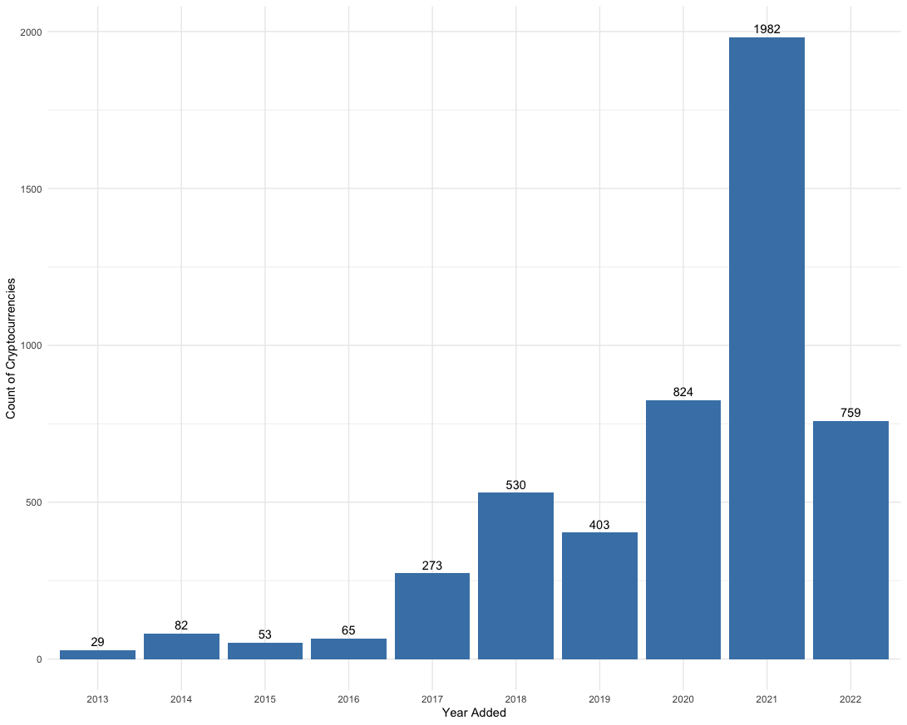
EXPLORATORY DATA ANALYSIS
Count of Cryptocurrencies added Yearly
The year 2021 had the highest addition of 1982 Cryptocurrencies.
759 new currencies have already been added this year (in a span of 5 months

Slide 14
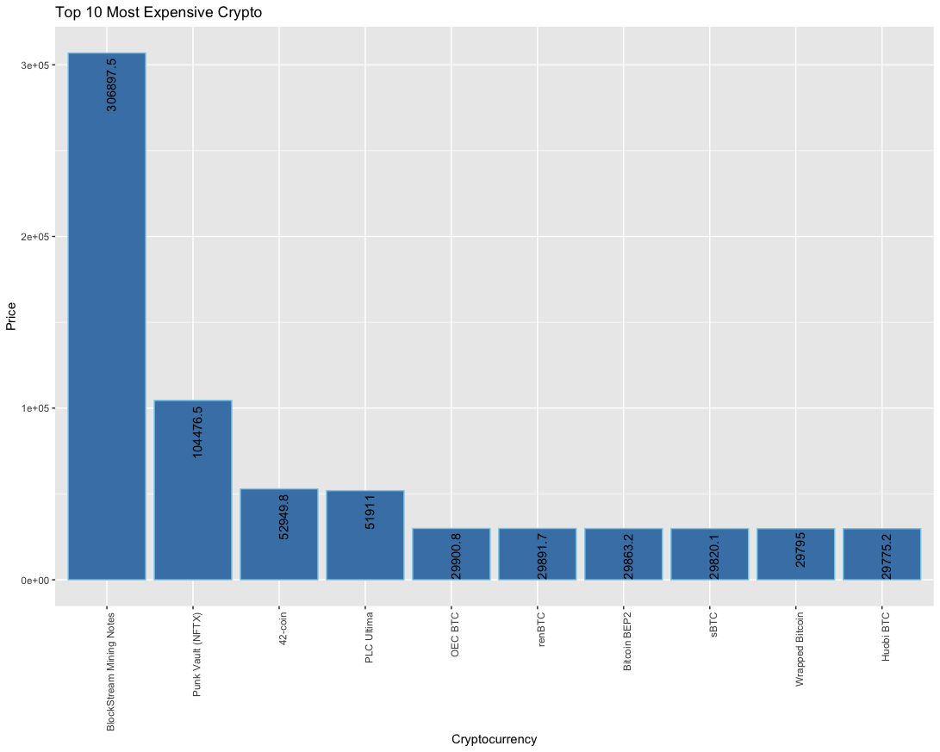
EXPLORATORY DATA ANALYSIS
Top 10 Most Valued Cryptocurrencies
Block Stream Mining Notes (BMN) is the most valued at $306,897.5 followed by Punk Vault (NFTX) at $104,476.5

Slide 15
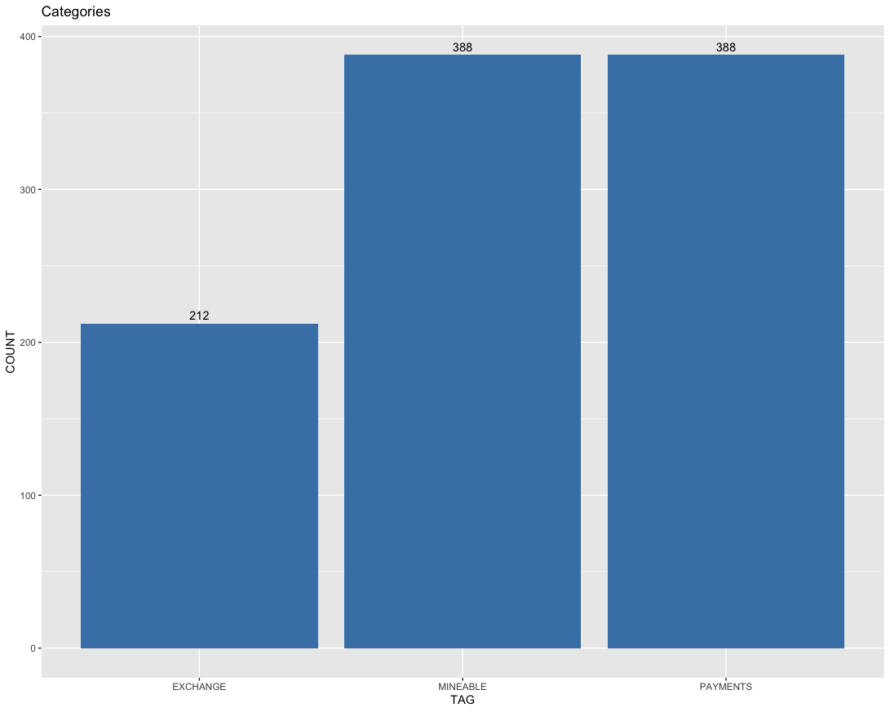
EXPLORATORY DATA ANALYSIS
Top 10 Most Valued Cryptocurrencies
Equal number (388) of Cryptocurrencies are categorized as MINEABLE and PAYMENTS
212 Cryptocurrencies are being used for exchanges

Slide 16
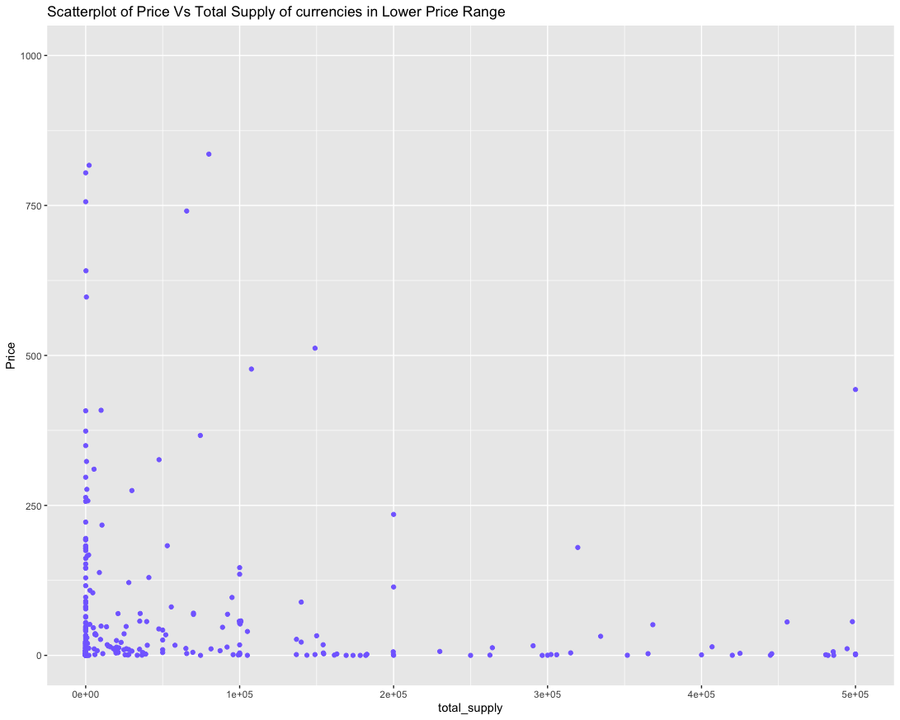
EXPLORATORY DATA ANALYSIS
Scatterplot of Price Vs Total Supply of currencies in Lower Price Range
The plot depicts the denser portion of the Crypto Currencies in the Low Value range
It is not feasible to depict all the currencies in a single plot considering the immense variation in Price and Supply
However, it is understood that Cryptocurrencies with Lower Supply have higher Prices and vice versa. The cluster in the Low Price- Low Supply region indicates the presence of other factors in determining the value of a cryptocurrency

Slide 17
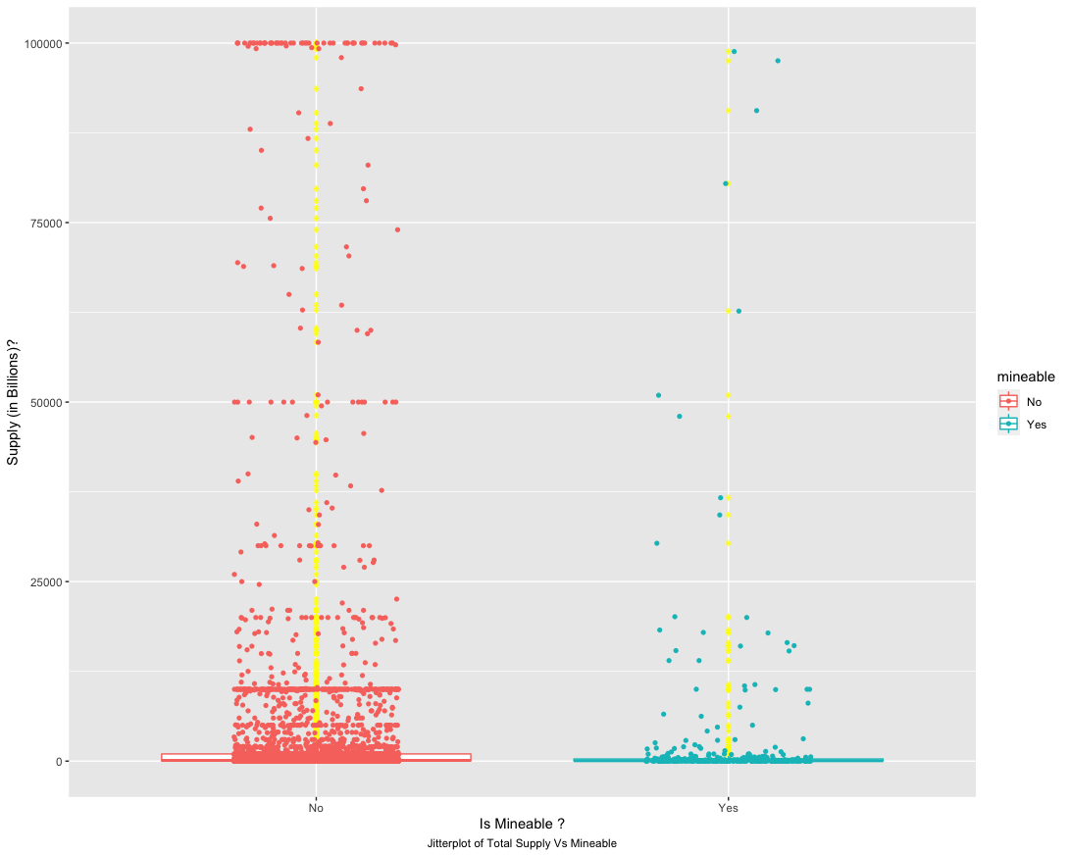
EXPLORATORY DATA ANALYSIS
Jitter plot of Total Supply Vs Mineable
The Total Supply of Mineable Plot is less dense than the non-Mineable
This shows the extent of growth for Mineable currencies
The non-mineable on the other hand has very high supply, indicating high volume of cryptocurrency already in circulation.

Slide 18
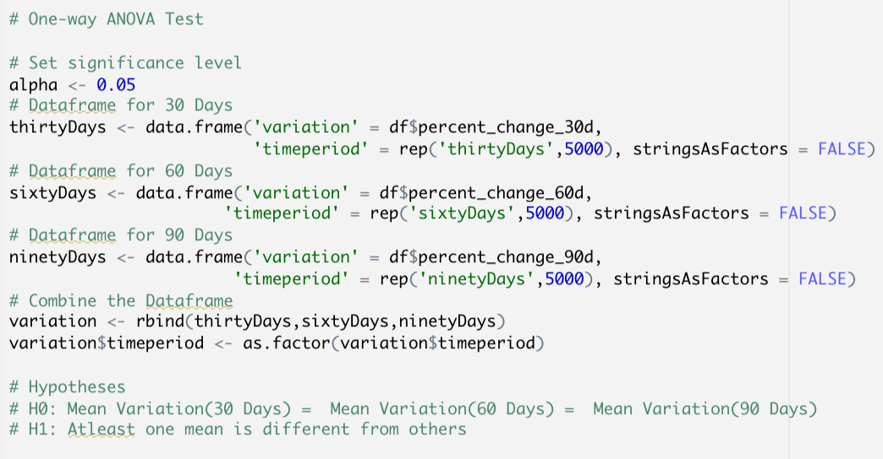
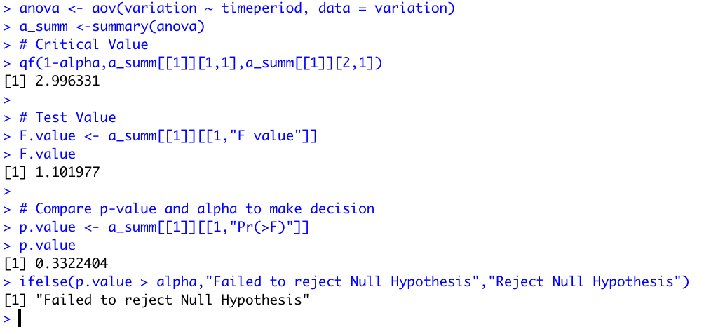
ANOVA
The Analysis of Variance or ANOVA test is performed to analyze if the mean percent change of all cryptocurrencies over different time periods are equal.
NULL hypothesis states that the mean is equal.
Failed to reject the Null hypothesis
This raises the question of whether prices of cryptocurrencies are dependent on each other.

Slide 19
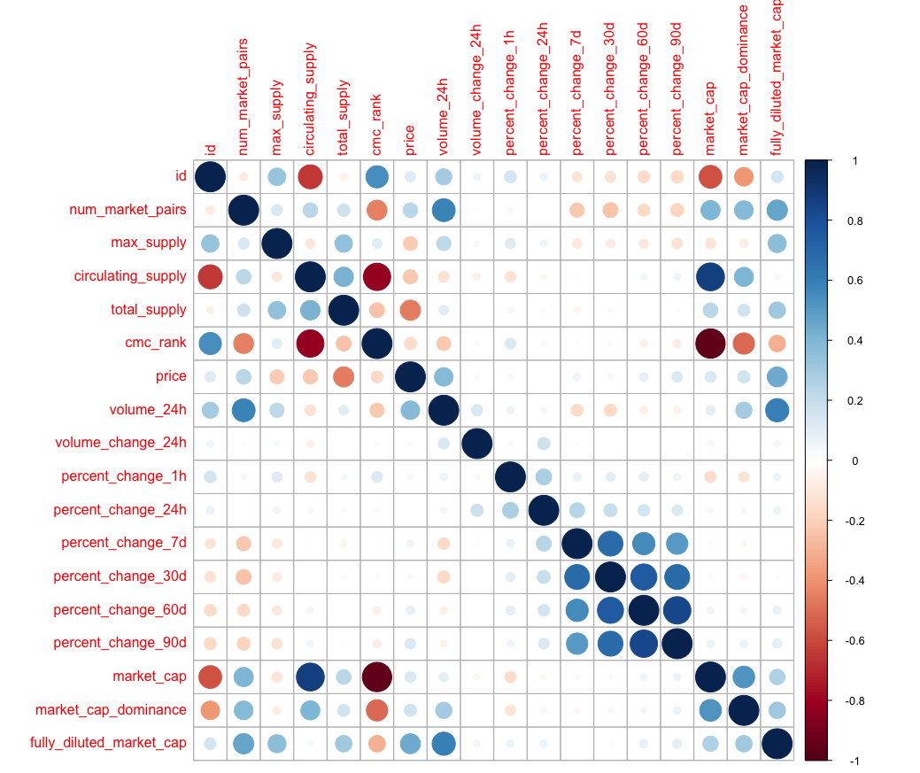
Correlation Analysis
Percent Changes shows high correlation between each other
Total Supply has a negative correlation with Price
Volume in 24 H has a positive correlation with the number of market pairs
CMC Rank has a high correlation with market cap dominance

Slide 20
Database for Cryptocurrencies using SQL
The Analysis shows that cryptocurrencies are highly unpredictable
Price of a cryptocurrency are affected by many more unknown factors.
Effective to have a database which stores data larger data pertaining to cryptocurrencies daily.
Querying this database would answer the questions (business questions) raised by new crypto investors.
This database could further be used to create services (dashboards of insights, predictive models of prices and so on) to continuously analyze cryptocurrency.

Slide 21
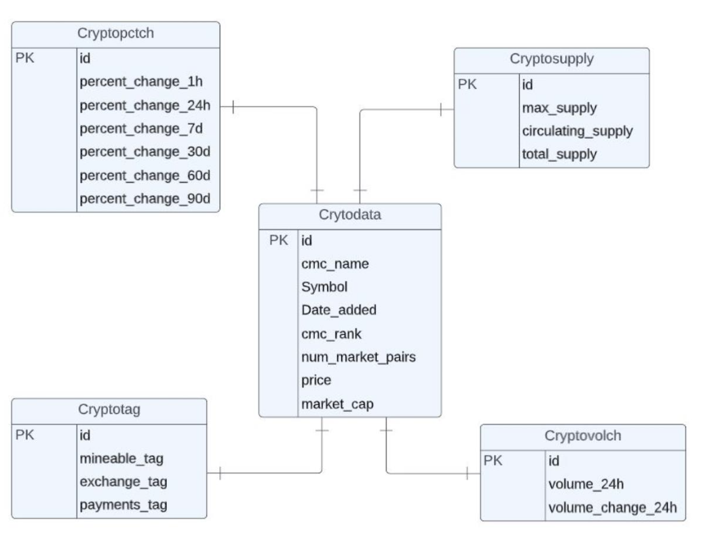
Entity Relationship Diagram
Normalization was performed and the main dataset was broken down into five tables. These tables contain information about cryptocurrencies, their supply, coin volume, tags and historical changes in prices.

Slide 22
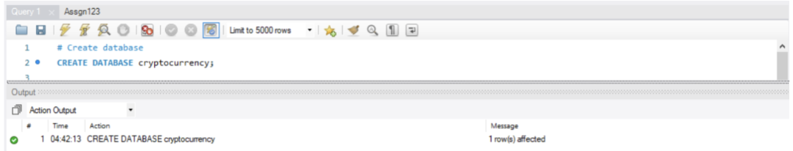
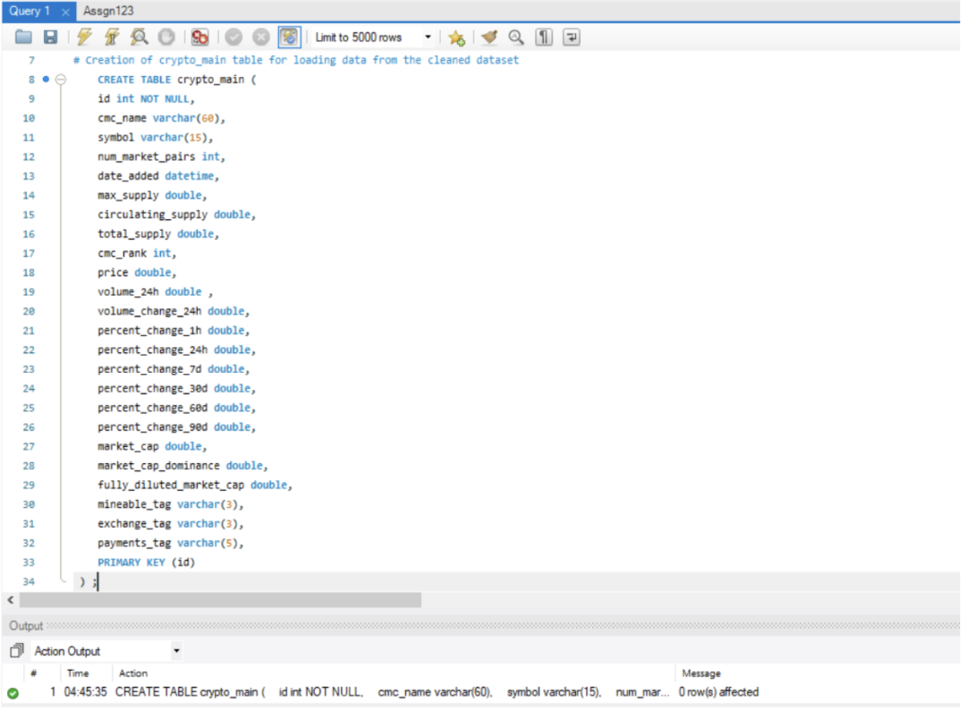
Data Preparation
Creation of Database
The schema cryptocurrency was created for storing the tables related to this project
Creation of Tables
A new table structure was created using the CREATE TABLE() command for loading the dataset.

Slide 23
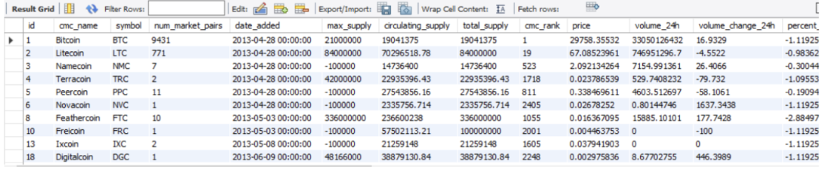
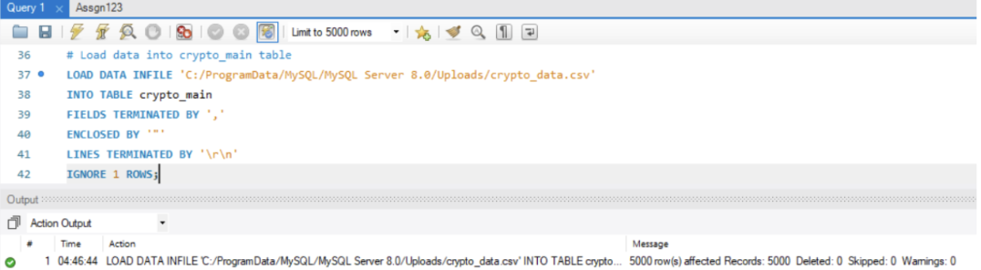
Data Preparation
The cleaned dataset was loaded into the crypto_main table using the LOAD DATA command
After loading data, the records got reflected in the crypt0_main table.

Slide 24
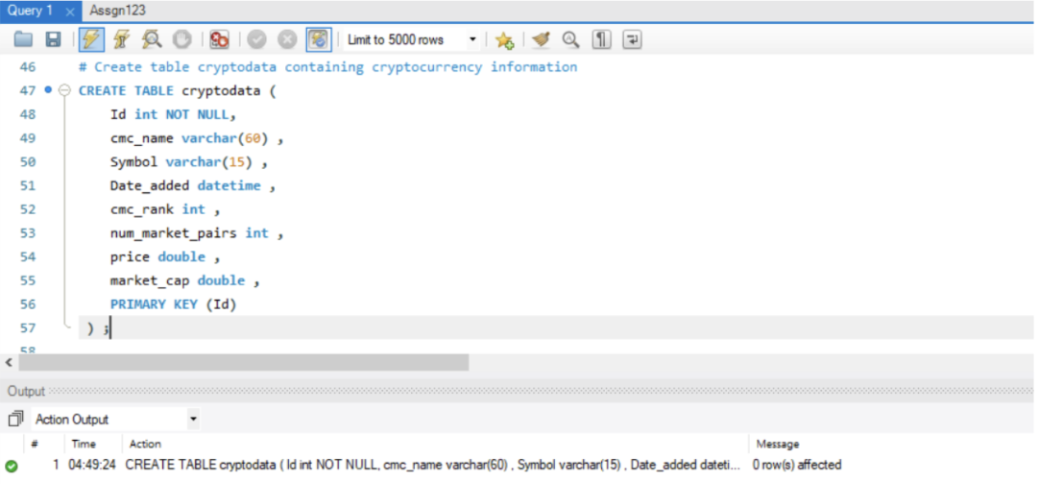
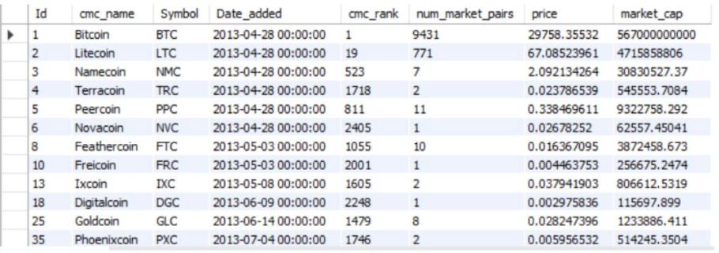
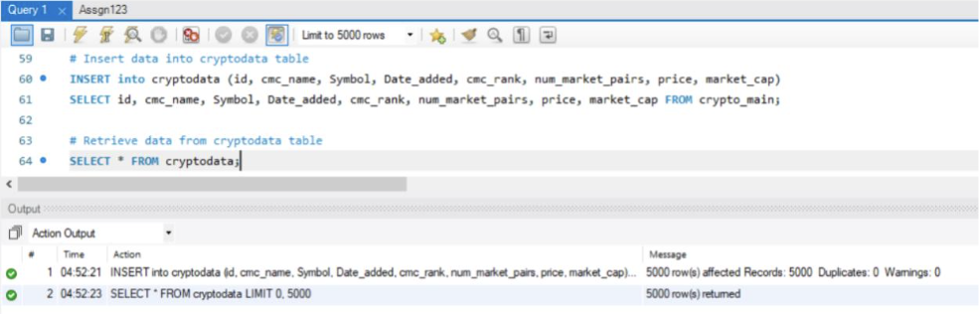
Data Preparation
CREATE TABLE
The data was inserted from the main table using the INSERT and SELECT command.
The records in the cryptodata table were retrieved and validated.

Slide 25
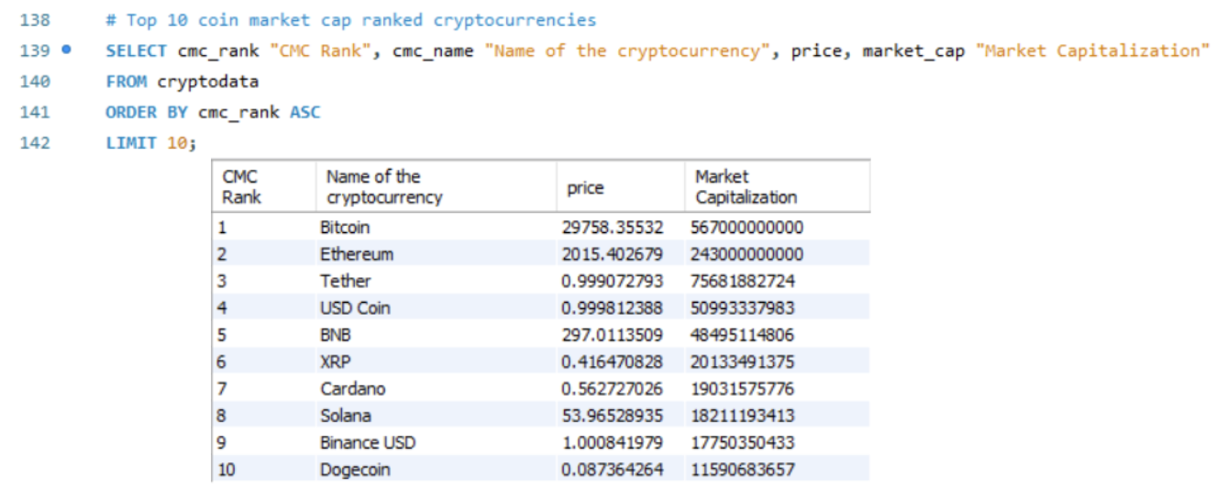
Analysis
Top ranked cryptocurrencies
Bitcoin has been ranked 1st with a price value of 30,000 approx.
Bitcoin has a market capitalization of 567 billion

Slide 26
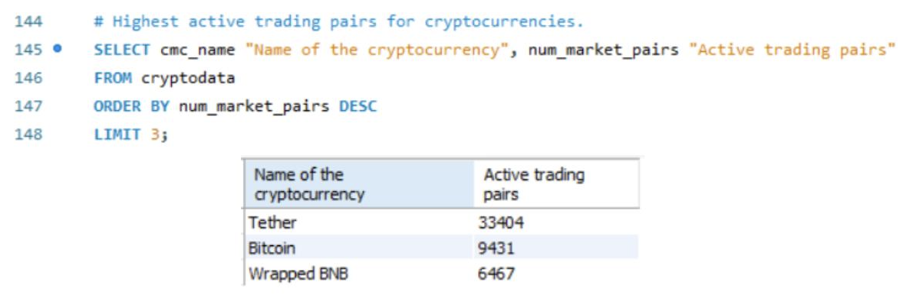
Analysis
Highest active trading pairs for cryptocurrencies.
Tether has the highest number of active trading pairs available. i.e., it accepts other 33404 cryptocurrencies in exchange.
Next come Bitcoin which accepts 9431 other cryptocurrencies.

Slide 27
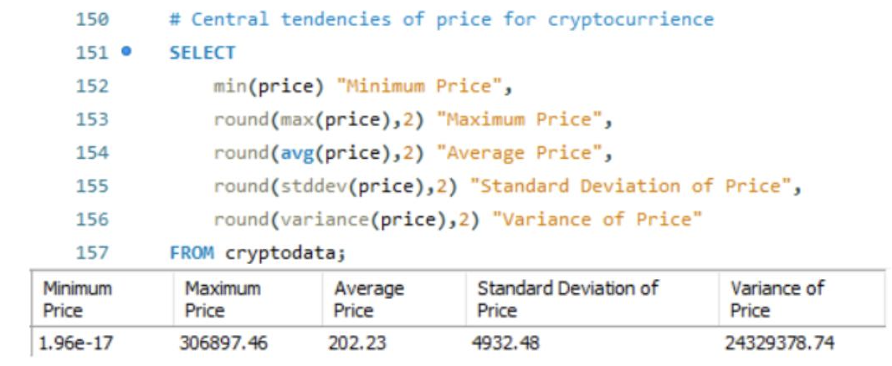
Analysis
Obtain descriptive statistics for price and volume of cryptocurrencies
The minimum price was in cents and the maximum price went up to 3,06,900 USD.
The spread in the price attribute was around 4932 USD.

Slide 28
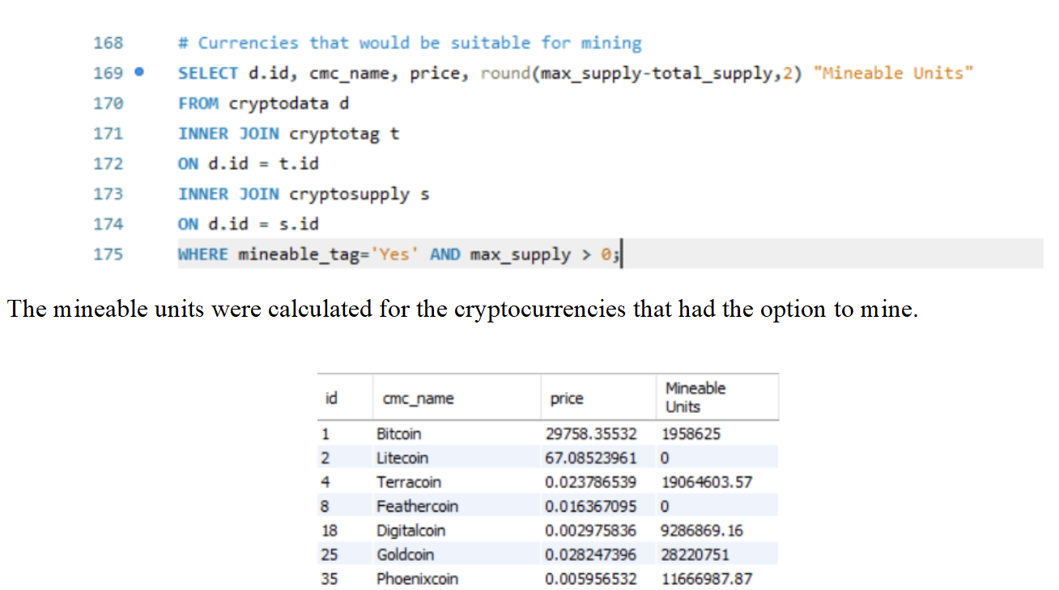
Analysis
Currencies that would be suitable for mining
Bitcoin had around 20,00,000 mineable units left.
The 0 in the mineable units mean that those cryptocurrencies don’t have any mineable units left and they are maxed out. Litecoin and Feathercoin are of that type.

Slide 29
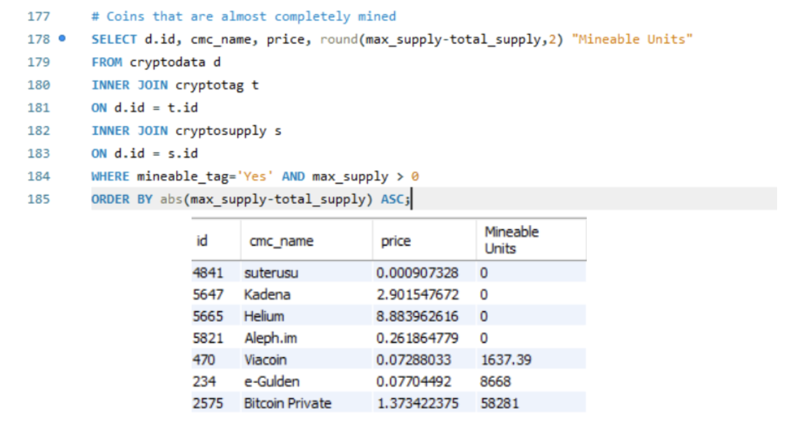
Analysis
Coins that are almost completely mined

Slide 30
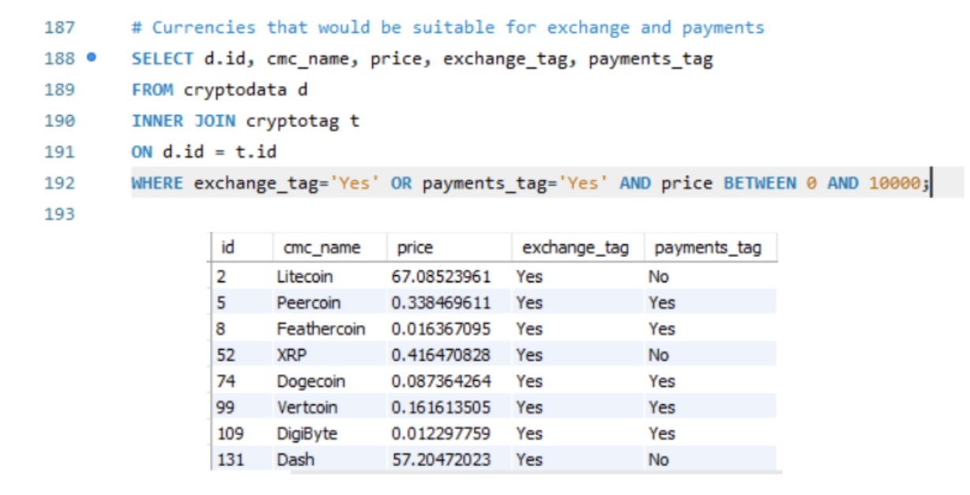
Analysis
Currencies that would be suitable for exchange and payments

Slide 31
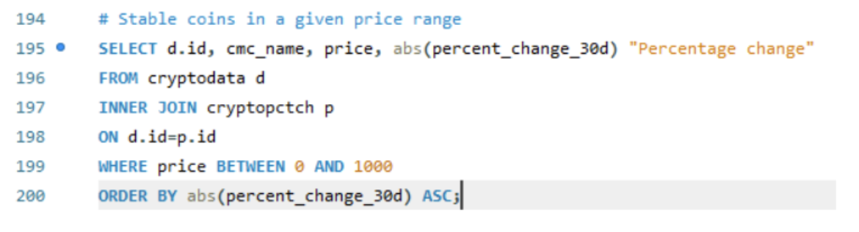
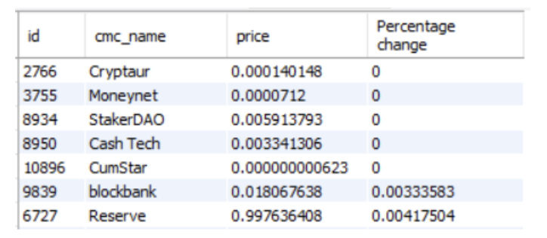
Analysis
Stable coins in a given price range

Slide 32
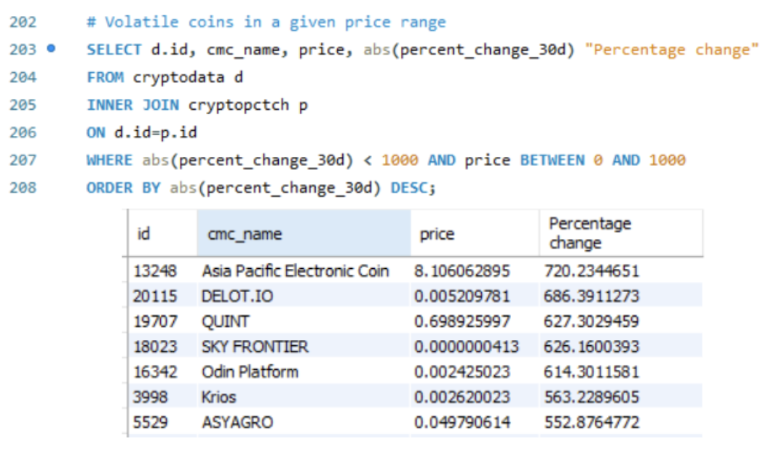
Analysis
Volatile coins in a given price range
Asia Pacific Electronic coin had the highest percentage change of 720% in the past 30 days
Then comes DELOT.IO with 686% change during the last 30 days.

Slide 33
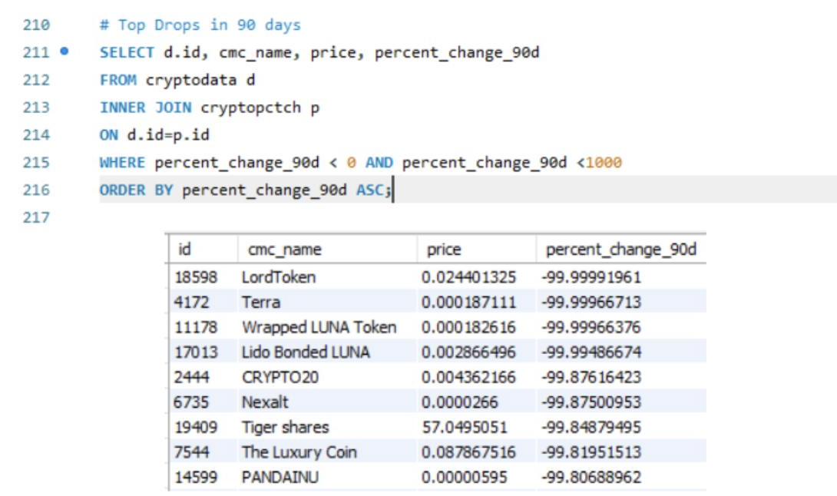
Analysis
Top Price Drops in 90 days
Almost 100% drop in the percentage changes

Slide 34
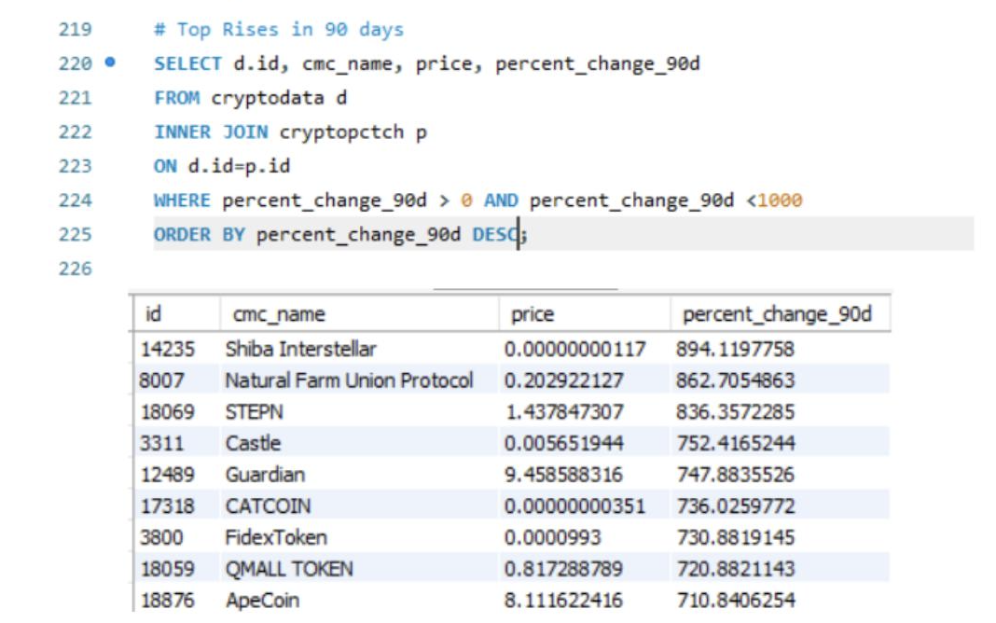
Analysis
Top Rises in 90 days
Shiba Interstellar had a huge rise in price accounting to 894% of increase in its price for a duration of 90 days
Natural Farm Union Protocol had a rise of 862% with the current price value in cents.

Slide 35

CONCLUSION
The top ranked cryptocurrencies by coin market cap includes Bitcoin with current price value of 29,758 USD, Ethereum with a price value of 2015 USD and Tether with price value in cents.
Active Trading Pairs: Tether (33404),Bitcoin (9431)
Mineable: Bitcoin had around 20,00,000 mineable units left and few cryptocurrencies like Litecoin and Feathercoin had 0 mining units.
Almost completely mined: Suterusu, Kadena, Helium and Aleph.im
Cryptocurrencies like Peercoin, Dogecoin, Vertcoin, DigiByte are suitable for both exchange and payments whereas Litecoin and Dash are only suitable for exchange.
Stable coins: Cryptaur, Moneynet, Cash Tech
Volatile coins: Asia Pacific Electronic Coin, Delot.io, Krios, Odin Platform were identified for a given period.
A drop of almost 100% and a rise of almost 862% in the price changes was recorded for a duration of 90 days.

Slide 36

REFERENCES
The future of cryptocurrency: what’s next for this craze? - GWI. (2022). Retrieved 17 May 2022, from https://www.gwi.com/connecting-the-dots/future-of-cryptocurrency
Cryptocurrency Prices, Charts and Market Capitalizations | CoinMarketCap. (2022). Retrieved 17 May 2022, from https://coinmarketcap.com/
What Is Fully Diluted Market Cap in Crypto?. (2022). Retrieved 17 May 2022, from https://www.one37pm.com/nft/what-is-fully-diluted-market-cap-in-crypto#:~:text=A%20fully%20diluted%20m
Bybit Learn | Bitcoin (BTC) Dominance: How It Changes the Way You Trade Crypto. (2021). Retrieved 17 May 2022, from https://learn.bybit.com/investing/what-is-bitcoin-dominance/

